Slide 1
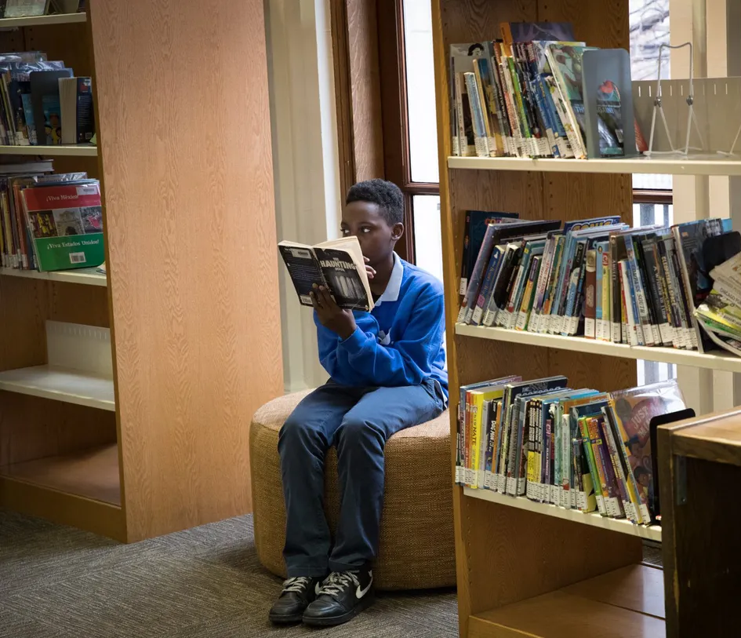
Who is the Public in Our Public Libraries?
Exploring the Spatial Variations of Library Services in Chicago, IL
Alexandra “Ola” Zalecki
Notes:
Introduce yourself, your project

Slide 2
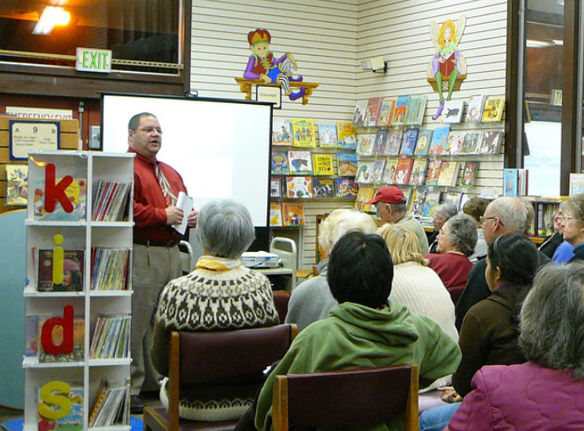
ABOUT THE PROJECT
“These days, however, libraries are more like bustling community centers, where being at least somewhat noisy is the new normal, especially when kids are involved” (MacPherson, 2023)
Inequity
Access
Urban vitality
Notes:
Going to my local public library since I was a kid but started frequenting libraries consistently during my remote year. There was one day where I decided to visit some libraries outside my neighborhood to get a change of scenery while writing an essay. I hop onto the Blueline get after off at the 5th spot walk to the closest library. I get in and sit down and leave 15 minutes later because I can’t get any work done. People are talking, kids are screaming their heads off. As I’m leaving frustrated, I think to myself about what the world has come to. Libraries were supposed to be quiet.
Karen MacPherson, a librarian and former children’s and youth services coordinator at Takoma Park Maryland Library, describes this phenomenon of changing noise levels as reflective of the shifting uses of library space. She claims that because libraries are expanding their programs with a focus towards socializing and community involvement, libraries are evolving into louder “bustling community centers.”

Slide 3
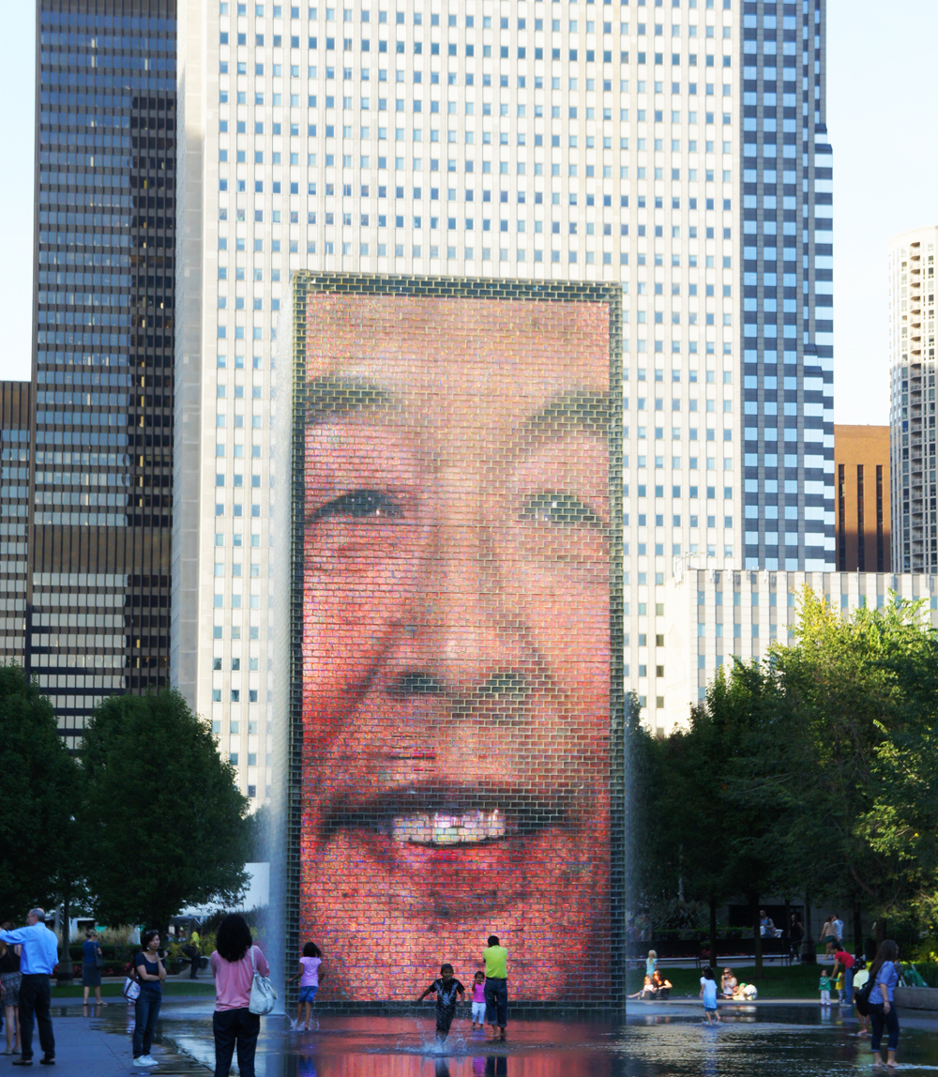
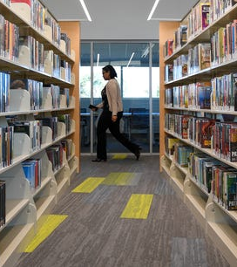
What exactly is “public space”?
1. Open to the public
2. In public ownership
3. Physically accessible to the public
Why use libraries as the “case”?
1. Prevalent across the US
2. Rarity of public indoor spaces
3. Purpose is to serve their communities
Notes:
From the literature it seems like nobody can agree on what public space is exactly. At its most fundamental, public space…
Public spaces are places of community building and play. You socialize and mingle in public spaces, practice your freedom of speech. Public spaces can be stages of protest that encourage democracy and equality.
But there are varying degrees of publicness. A museum and the street are two forms of public space but are public in very different ways.
Libraries are just one form of public space. But they’re a valuable one to consider for a couple of reasons.
Libraries are one of the most expansive forms of public space. There are an estimated 117,341 libraries of all kinds in the United States and they’re almost anywhere where there are people.
Libraries are one of the few free to use public indoor spaces which makes them an important place to rest and shelter away from the elements.
Libraries have a civic duty to serve their communities and they will therefore be a reflection of them, their values and their needs.

Slide 4
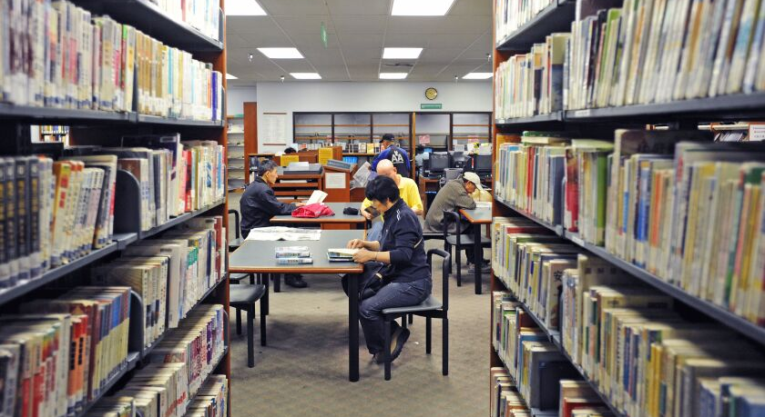
“…maintaining spaces where print books have more privileges than people seem to be unnecessary”
(Rodrigues Dantas, 2015)
“As change becomes ‘routine activity’, libraries must reimagine themselves as evolving organisms rather than static objects” (Hoyer, 2011).
Notes:
By considering library services we can use libraries as a way to gauge community needs. Especially considering that we live in a time where library services are changing. I want to ask the audience, “What is the purpose of a library?” “What do libraries do?”
Traditionally libraries have functioned as places to store and disseminate print material. But I want to encourage you all to look beyond just the books and consider non-traditional library services like…

Slide 5

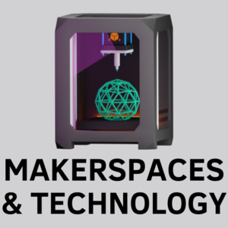





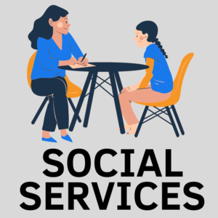
Notes:
In this project I focused on three of these types of services:

Slide 6
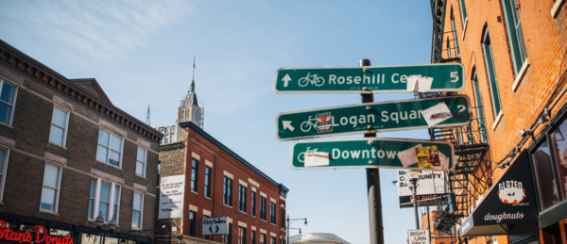
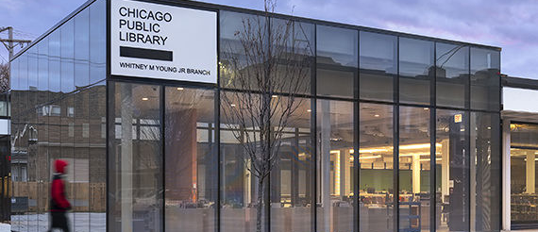
Question 1
RESEARCH QUESTIONS
Question 2
How do library service areas differ along socio-economic and demographic lines in Chicago, IL?
To what extent do the socio-economic and demographic characteristics shape the services, programming and amenities available at these libraries.

Slide 7
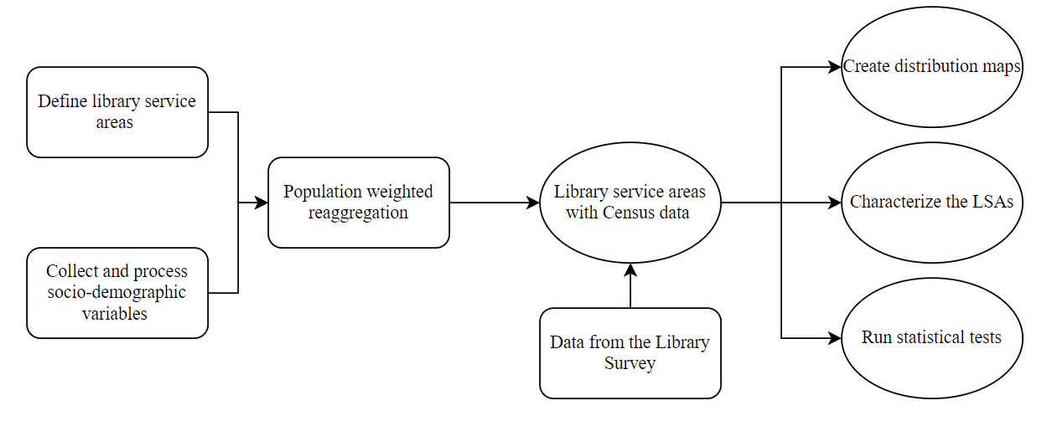
Part 1:
Characterizing the Neighborhood
Part 2:
Surveying Library Services
and Programming
Part 3:
Analyzing the Data

Slide 8
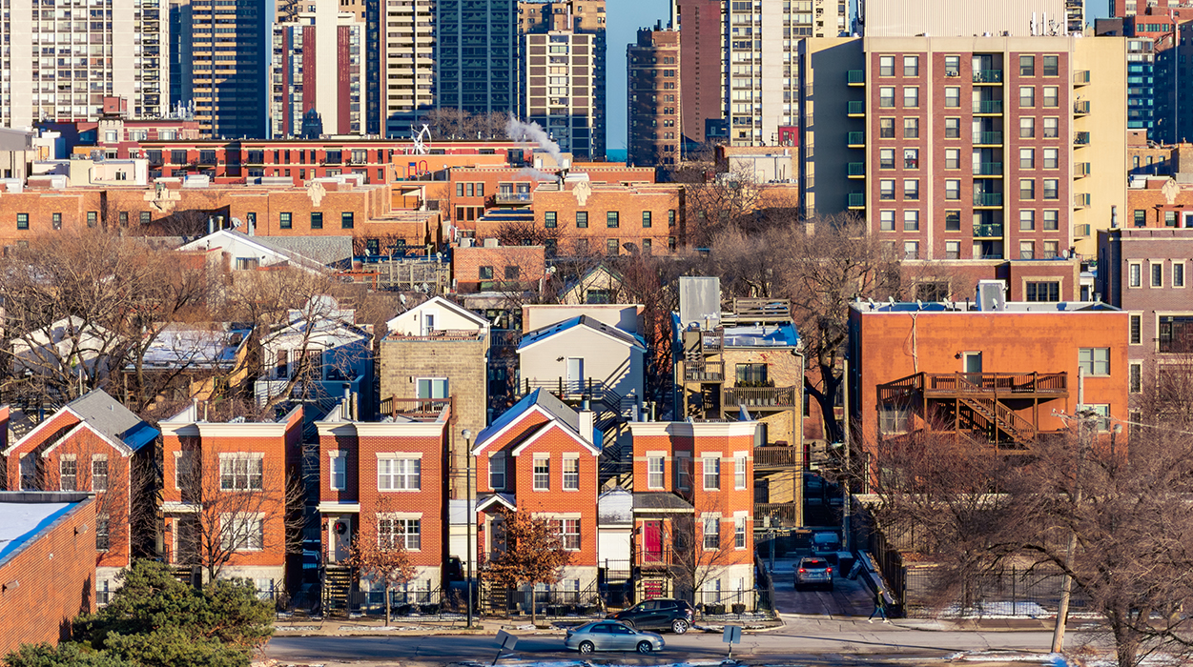
RESULTS

Slide 9
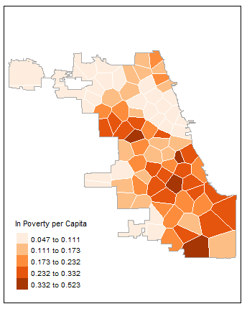
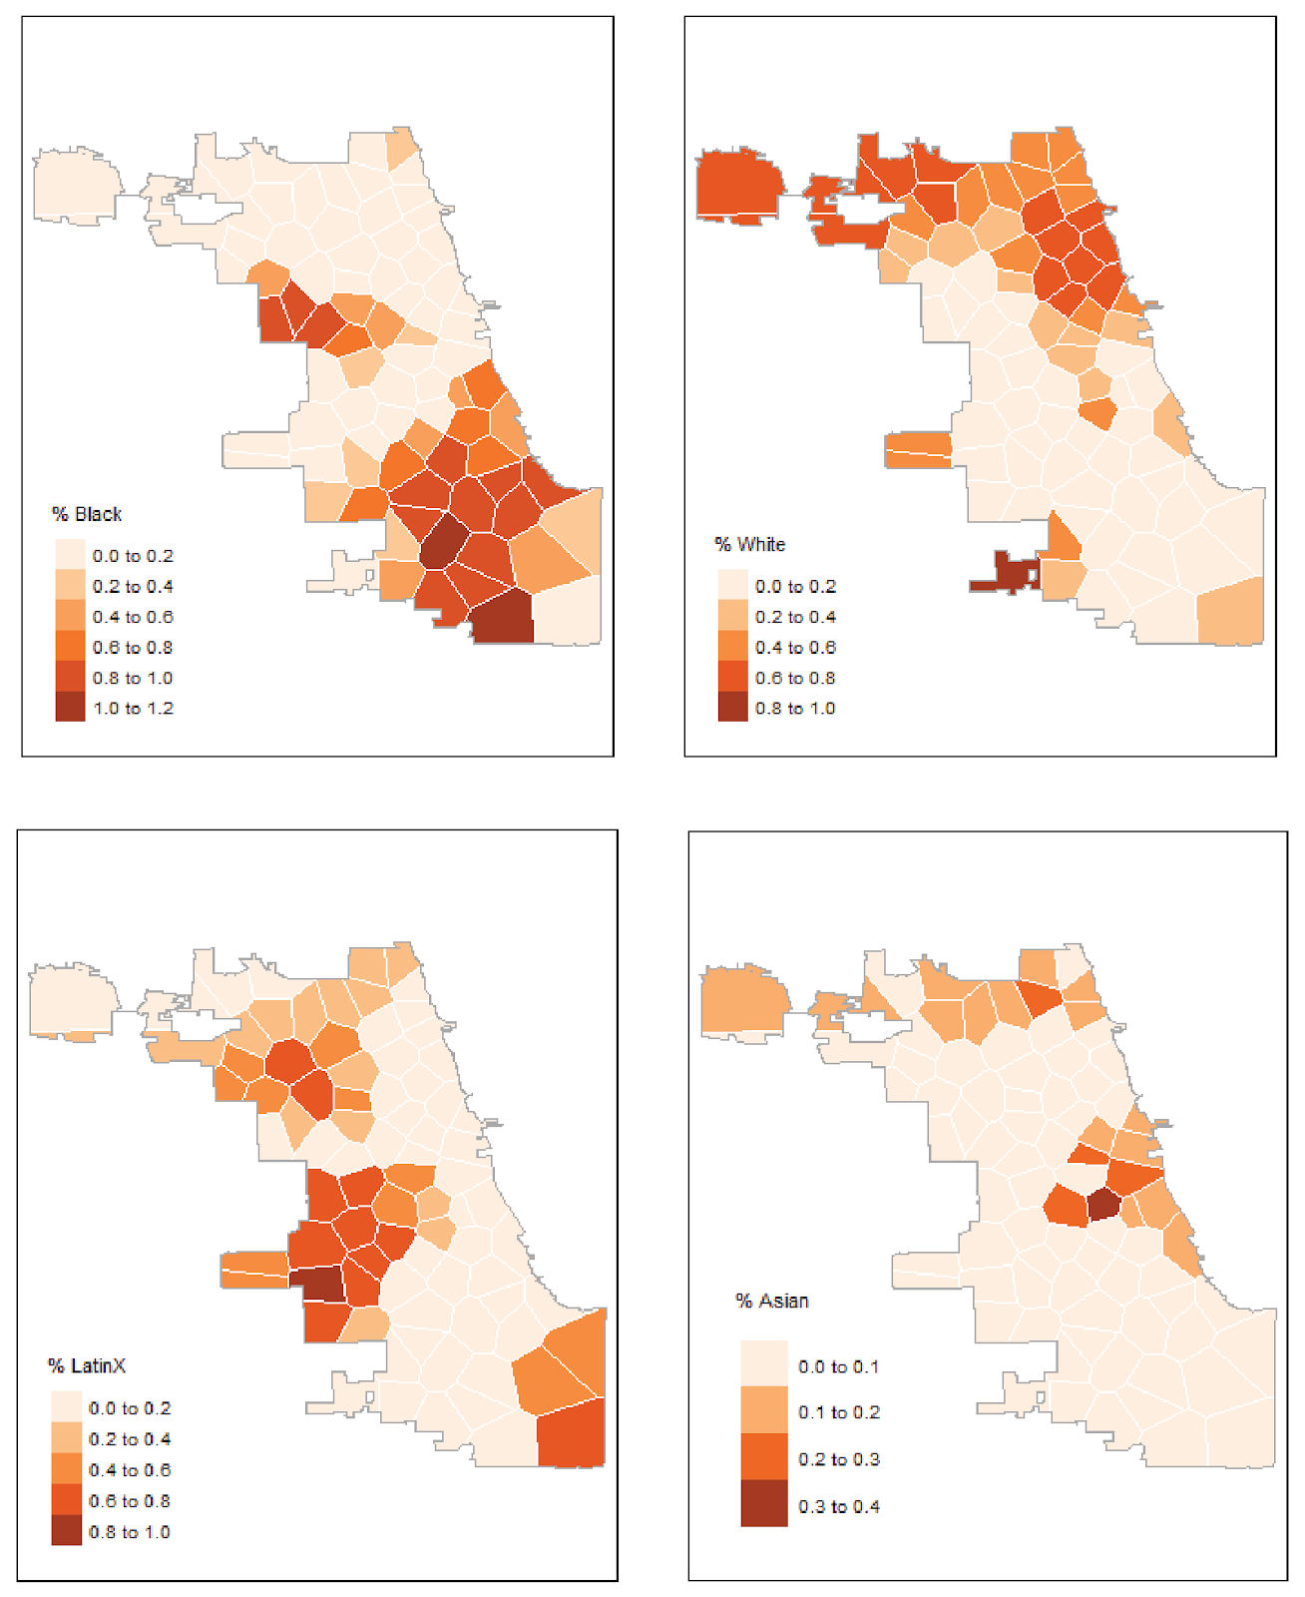

Slide 10
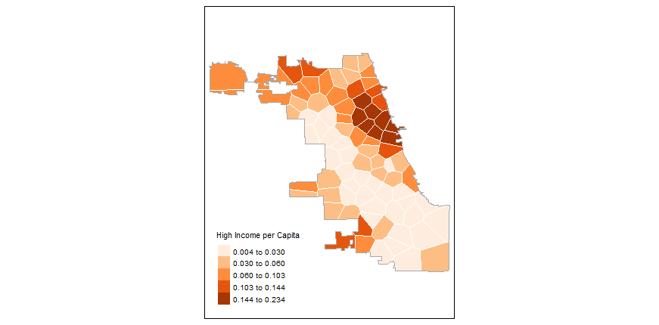
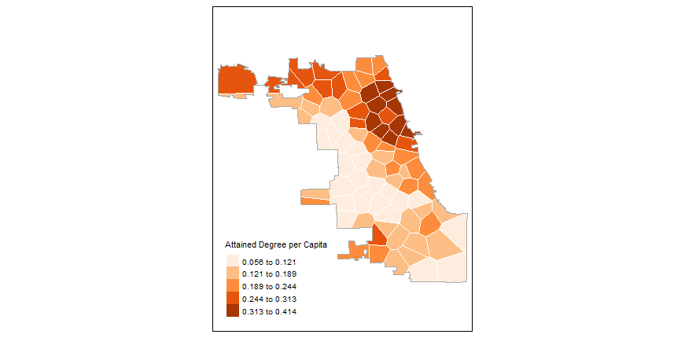
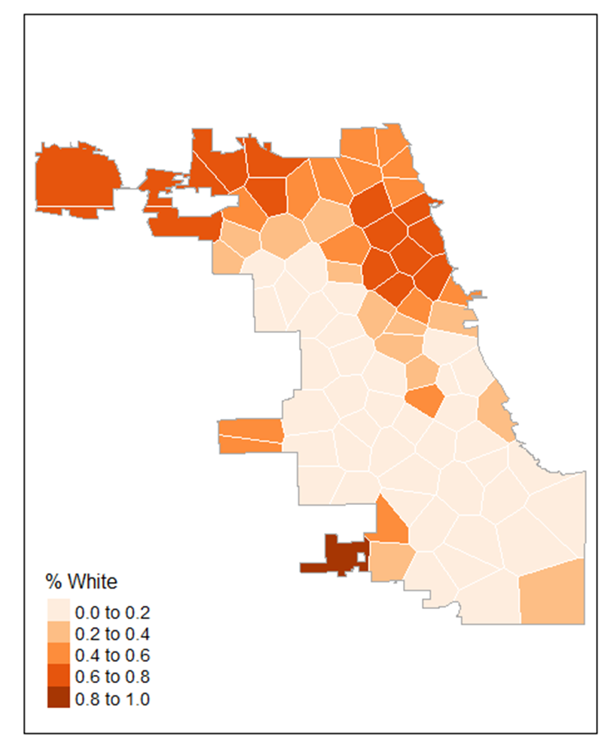

Slide 11
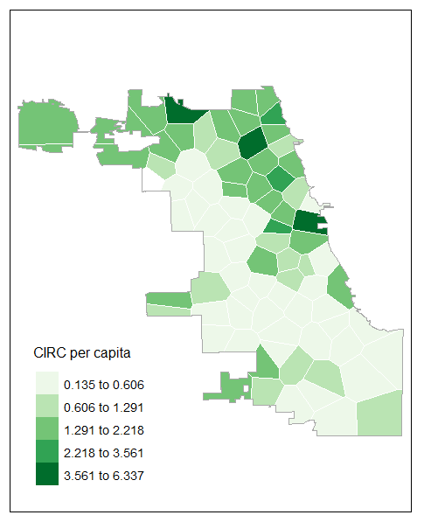
Notes:
So, what did we just learn? To answer our first question
Library service areas are not heterogenous across space and there are different kinds of publics across Chicago.
This is important because different publics will have different social needs and therefore different needs for the library to meet.
Circulation, one of the most commonly used metrics for library service, seem to only represent one kind of public.

Slide 12
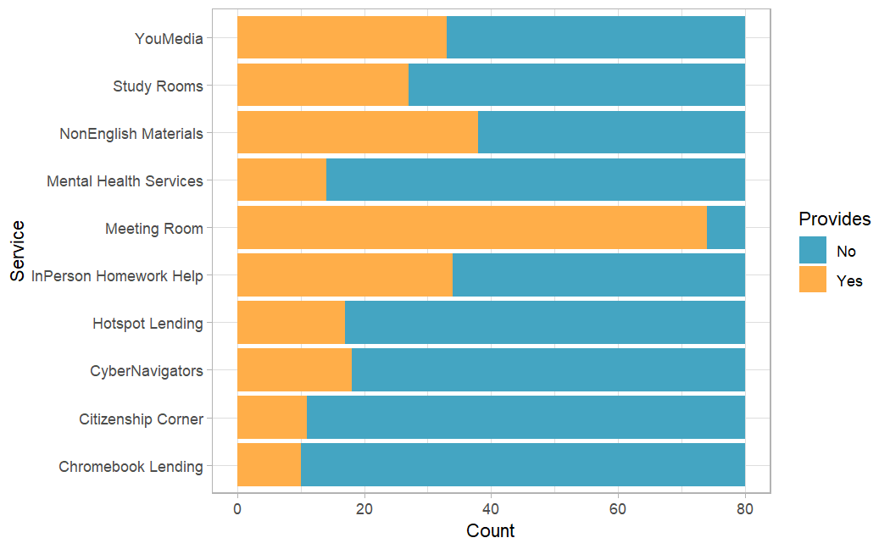
Notes:
Some non-traditional services were found in almost all public libraries including access to computers, meeting rooms and homework help. All 80 libraries had computers available at their facilities while 93% of libraries had a meeting room and 96% offered some form of homework help.
Less than 50% of the libraries offered In Person Homework Help (43%) Materials in a language other than English(48%)study rooms (34%), and YouMedia programming (41%). Less than 25% of the 80 libraries offered other kinds of non-traditional services like Cyber Navigators (23%), Citizenship Corner (14%), Mental Health Services (18%) and Hotspot Lending (21%).
Let’s look to Citizenship Corner as an example which is a program that includes spreads USCIS materials, enhanced collections on immigration and free assistance with the naturalization process.

Slide 13
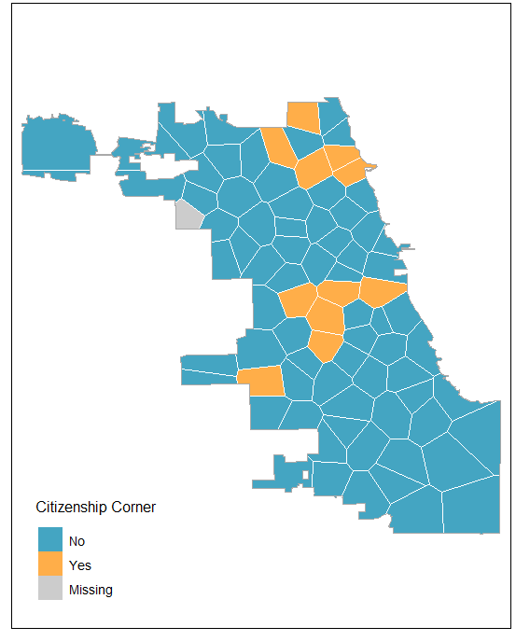
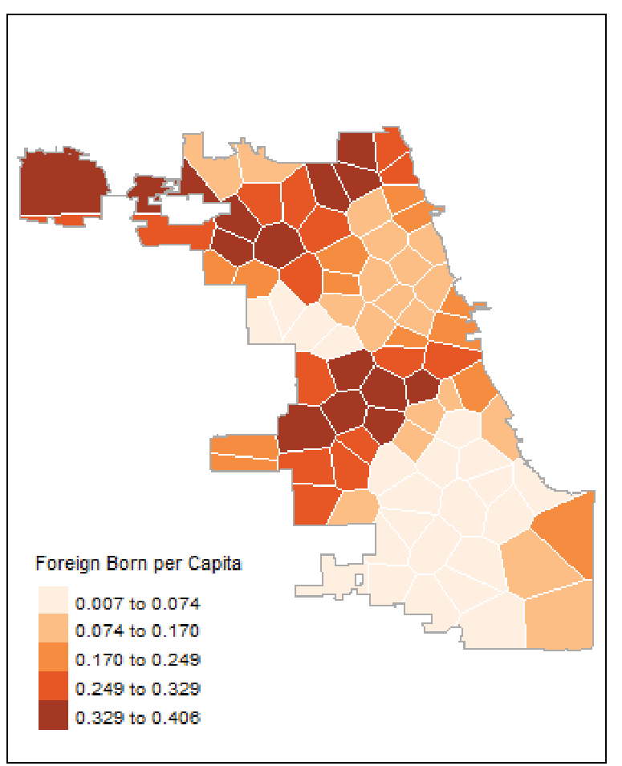
Notes:
Libraries that were identified as having Citizenship Corners were predominantly located in or near LSAs with foreign-born populations ranging from 20-40%.

Slide 14
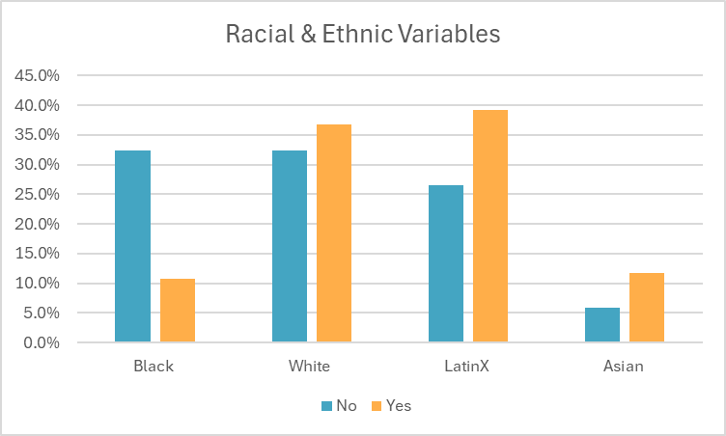
Notes:
LSAs that provide Citizenship Corner services have proportionally larger white (36.8%), Latinx (39.2%) and Asian (11.7%) populations compared to those that did not. On the other hand, LSAs that do not provide Citizenship Corner services had a proportionally larger Black population (32.3%) as opposed to the LSAs that did.

Slide 15
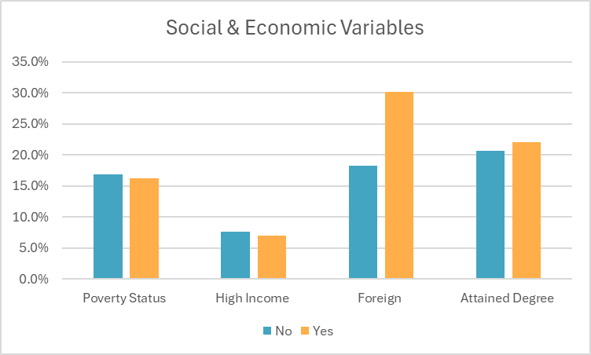
Notes:
As expected, the LSAs that provide Citizenship Corner had almost double the foreign-born population (30.1%) than the LSAs that did not (18.2%). The proportion of the population that is poor and high incomes between LSAs that do versus those that do not have Citizenship Corner was relatively even but LSAs that do provide Citizenship Corner had slightly smaller populations of both people in poverty and those with high incomes.

Slide 16
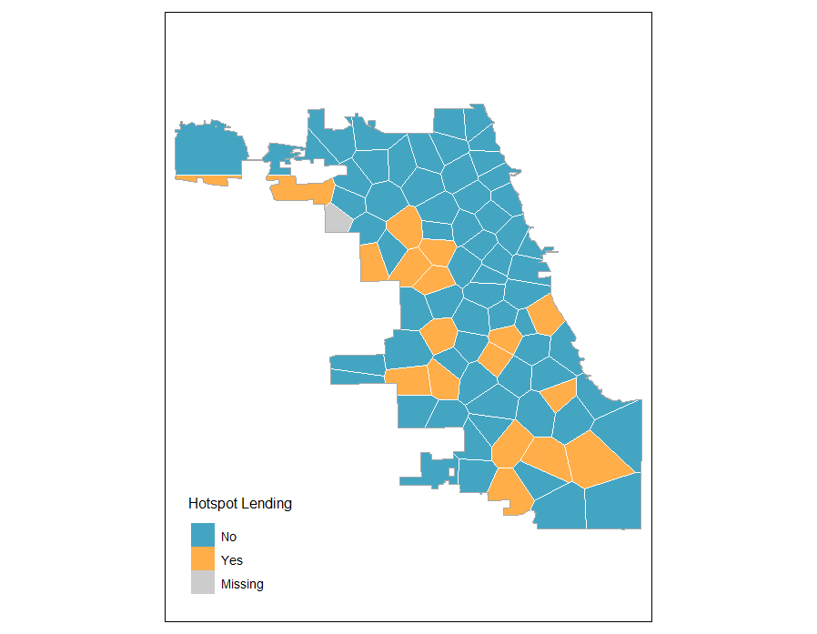
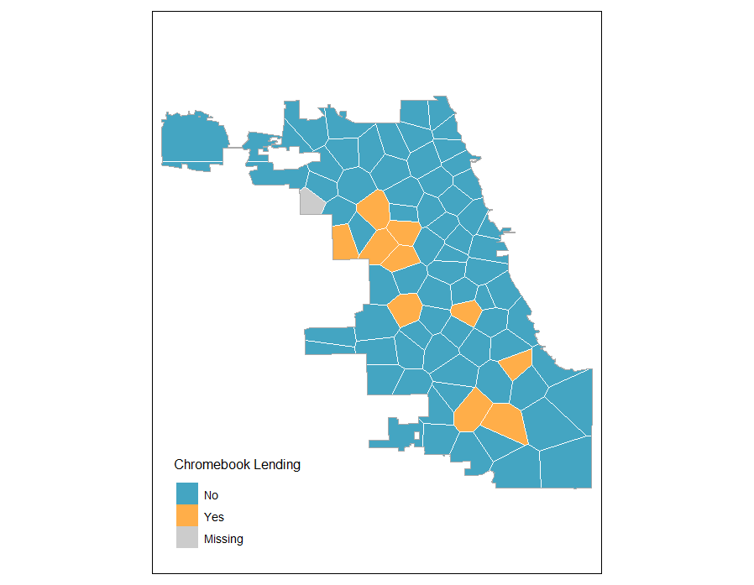
Notes:
Any resident of Chicago with an active library card can check out a mobile wifi-hotspot and/or a google chromebook for three weeks. These short term loans are an attempt to promote digital inclusion, bridge the technology gap and deal with digital deserts where there is no or very limited access to the internet. What is interesting is that unlike print materials that can be put on hold and transported from library to library, hotspots and chromebooks may only be picked up at locations that carry these devices. Out of the 80 libraries surveyed, there were 17 libraries(21%) that carry hotspots and 10 libraries(12%) that carry chromebooks.
Libraries that provide lending of hotspots are predominantly located on the South and West sides of the city in what appear to be small clusters (Figure 31). There are almost no libraries that carry hotspots on the North and Far north side and one library on the Northwest side (name library). In a similar being, libraries that provide lending of chromebooks follow this pattern but shrink in magnitude. All libraries that provide chromebook lending also provide mobile hotspot lending but not vice versa.

Slide 17
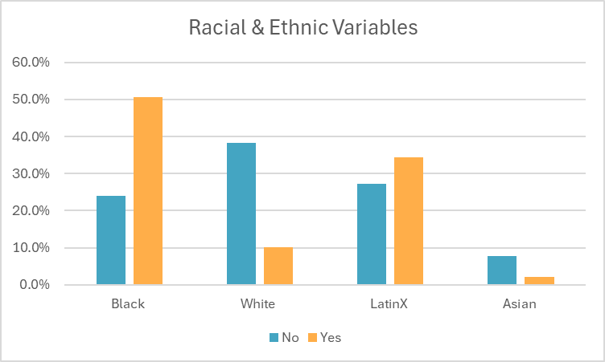

Slide 18
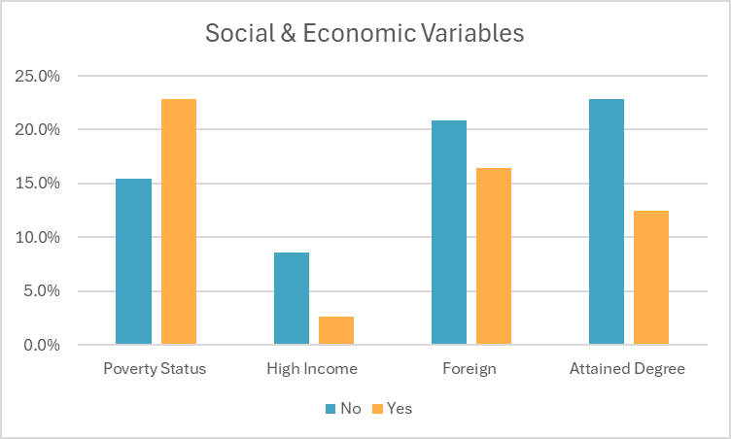

Slide 19
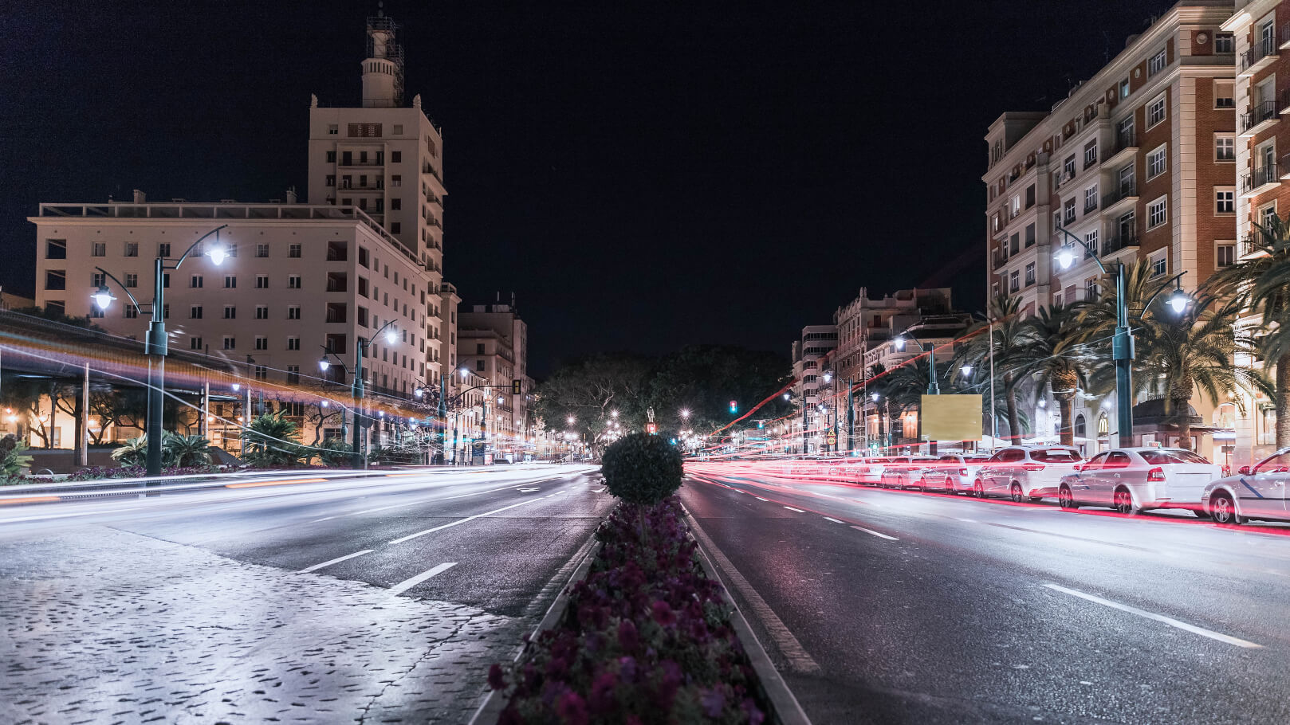
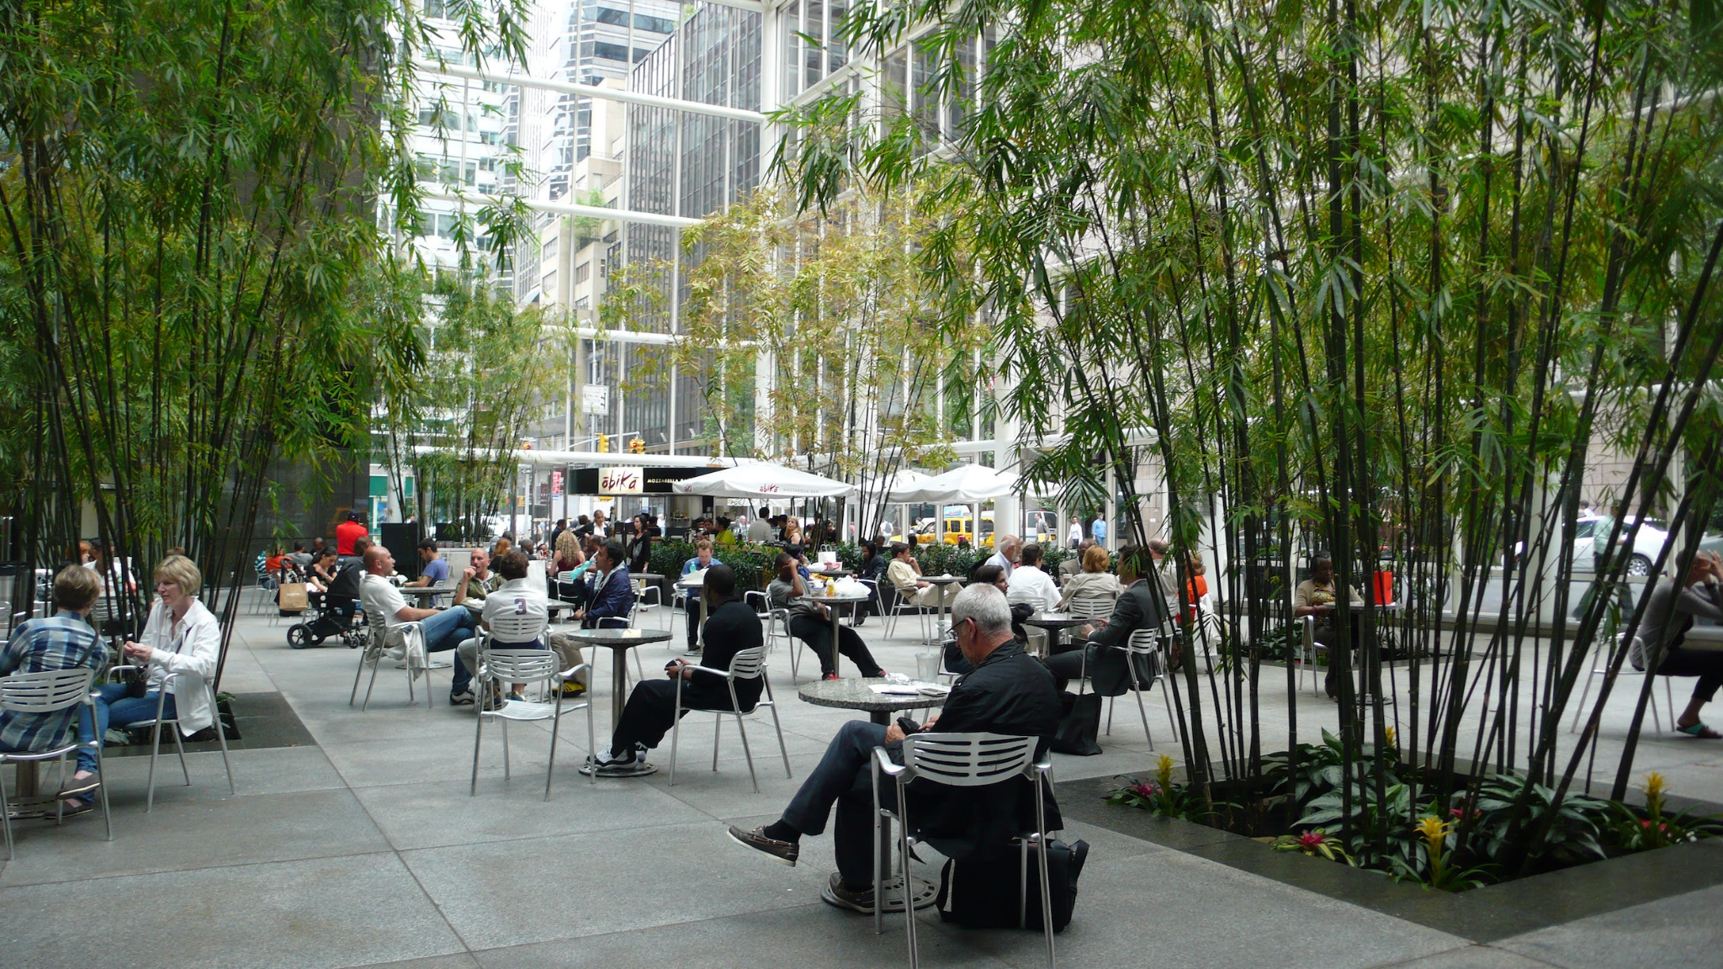
“The overall sense of the city’s genius loci - its spirit, its vitality, its splendor and successes, and the joys of urban life are visible in public space, as are its struggles, squalor, sufferings and conflicts” (Mehta, 2022)
Notes:
in a rapidly changing world, it is critical to consider the functions that libraries serve because these functions are a reflection of community needs and gaps in the social infrastructure.
This study has the potential to shed light on which libraries may need more funding to continue to provide programs for community needs that are not being met anywhere else. Although this study is fundamentally an exploratory one with the aim to understand spatial variation of library services, this research may help inform policy that can help improve the quality and access to library services and programs. At the least, I hope that the research here provides insight into the specific ways that library services are distributed across space in Chicago and encourages a more relevant understanding of library services.

Slide 20
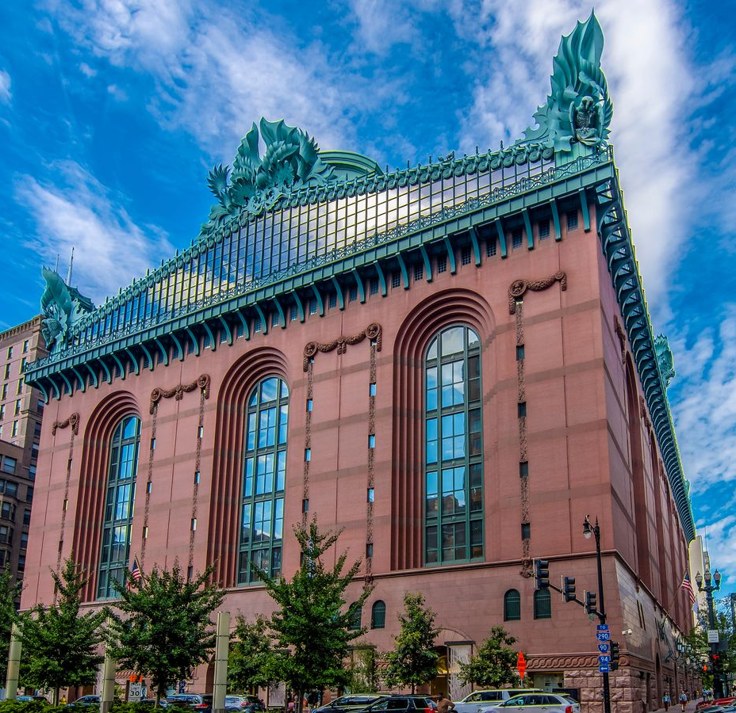
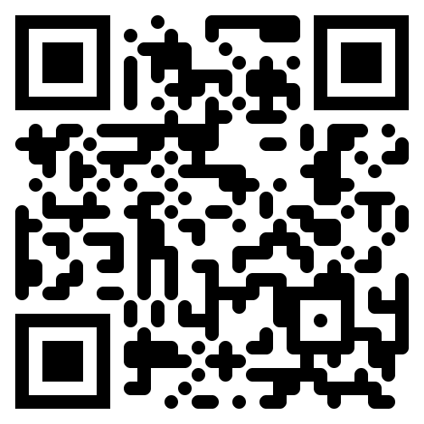
THANK YOU!
Acknowledgments
Middlebury Geography Department
- Professor Peter Nelson
- Professor Jessica L’Roe
Friends and Family
Oriole Park Public Library
Portfolio
Questions?Comments?
Email
azalecki@middlebury
Github
@azalecki

